Slide 1


Open Source Modelling in R
Vaibhav P. Vasani
Assistant Professor
Department of Computer Engineering
K. J. Somaiya College of Engineering
Somaiya Vidyavihar University
Notes:
https://srdas.github.io/MLBook/IntroductoryRprogamming.html#data-frames

Slide 2
Data Frames
Data frames are the most essential data structure in the R programming language.
View(data) ##rcode
Data frames in R are much more than mere spreadsheets
Data frames as databases,
There are many commands that we may use that are database-like, such as joins, merges, filters, selections, etc.
Packages such as dplyr and data.table are designed to make operations seamless, and operate efficiently on big data, where the number of observations (rows) are of the order of hundreds of millions.

Slide 3
Data frames can be addressed by column names, so that we do not need to remember column numbers specifically. If you want to find the names of all columns in a data frame, the names function does the trick. To address a chosen column, append the column name to the data frame using the “$” connector, as shown below.
#THIS IS A DATA FRAME AND CAN BE REFERENCED BY COLUMN NAMES
print(names(data))
## [1] "Date" "Open" "High" "Low" "Close" "Volume"
## [7] "Adj.Close"
print(head(data$Close))
## [1] 100.34 108.31 109.40 104.87 106.00 107.91
The command printed out the first few observations in the column “Close”. All variables and functions in R are “objects”, and you are well-served to know the object type, because objects have properties and methods apply differently to objects of various types. Therefore, to check an object type, use the class function.
class(data)
## [1] "data.frame"

Slide 4
To obtain descriptive statistics on the data variables in a data frame, the summary function is very handy.
#DESCRIPTIVE STATISTICS
summary(data)

Slide 6
Let’s take a given column of data and perform some transformations on it. We can also plot the data, with some arguments for look and feel, using the plot function.
#USING A PARTICULAR COLUMN
stkp = data$Adj.Close
dt = data$Date
print(c("Length of stock series = ",length(stkp)))
## [1] "Length of stock series = " "1671"
#Ln of differenced stk prices gives continuous returns
rets = diff(log(stkp)) #diff() takes first differences
print(c("Length of return series = ",length(rets)))
## [1] "Length of return series = " "1670"
print(head(rets))
## [1] 0.07643307 0.01001340 -0.04228940 0.01071761 0.01785845 -0.01644436
plot(rets,type="l",col="blue")

Slide 7
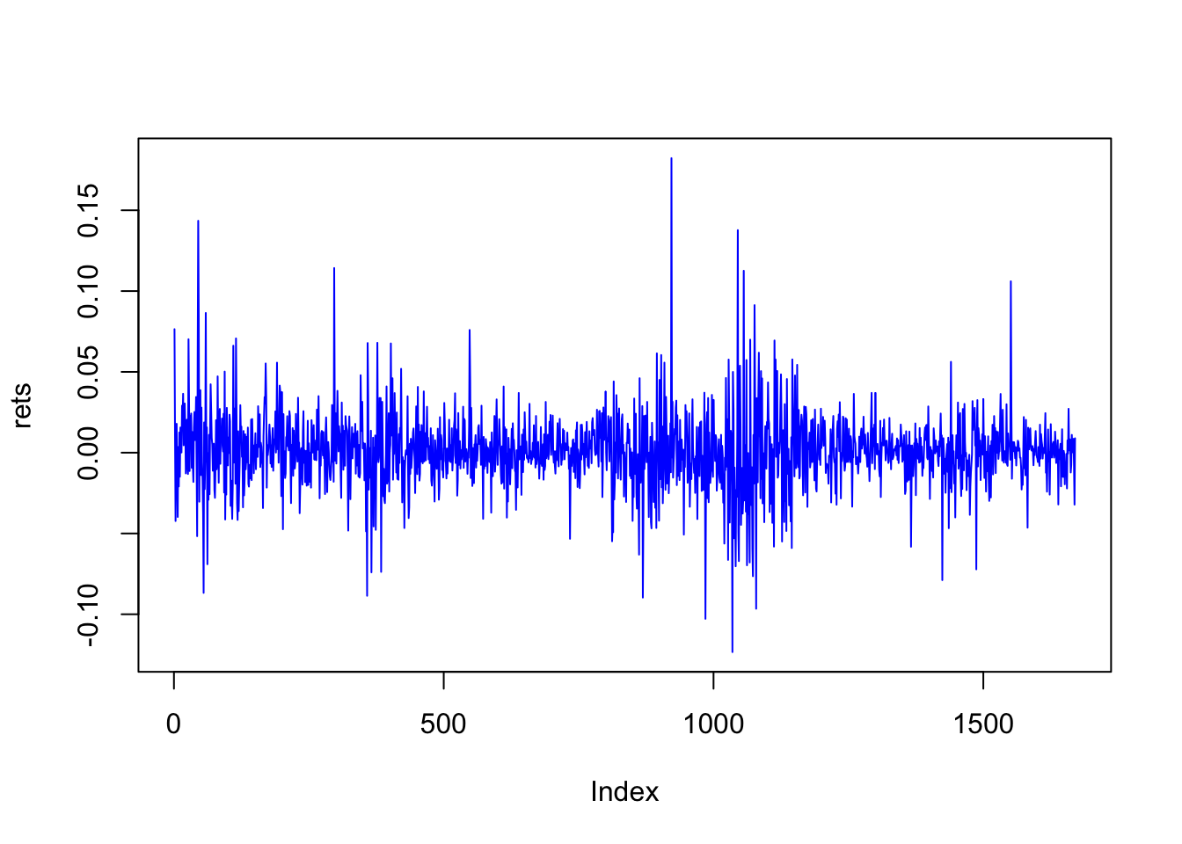

Slide 8
In case you want more descriptive statistics than provided by the summary function, then use an appropriate package. We may be interested in the higher-order moments, and we use the moments package for this.
print(summary(rets))
## Min. 1st Qu. Median Mean 3rd Qu. Max.
## -0.1234000 -0.0092080 0.0007246 0.0010450 0.0117100 0.1823000
Compute the daily and annualized standard deviation of returns.
r_sd = sd(rets)
r_sd_annual = r_sd*sqrt(252)
print(c(r_sd,r_sd_annual))
## [1] 0.02266823 0.35984704
#What if we take the stdev of annualized returns?
print(sd(rets*252))
## [1] 5.712395
#Huh?
print(sd(rets*252))/252
## [1] 5.712395
## [1] 0.02266823
print(sd(rets*252))/sqrt(252)
## [1] 5.712395
## [1] 0.359847

Slide 9
Notice the interesting use of the print function here. The variance is easy as well.
#Variance
r_var = var(rets)
r_var_annual = var(rets)*252
print(c(r_var,r_var_annual))
## [1] 0.0005138488 0.1294898953

Slide 10
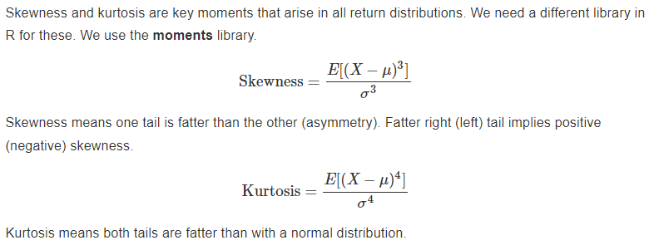
Higher-Order Moments
Skewness and kurtosis are key moments that arise in all return distributions. We need a different library in R for these. We use the moments library.

Slide 11
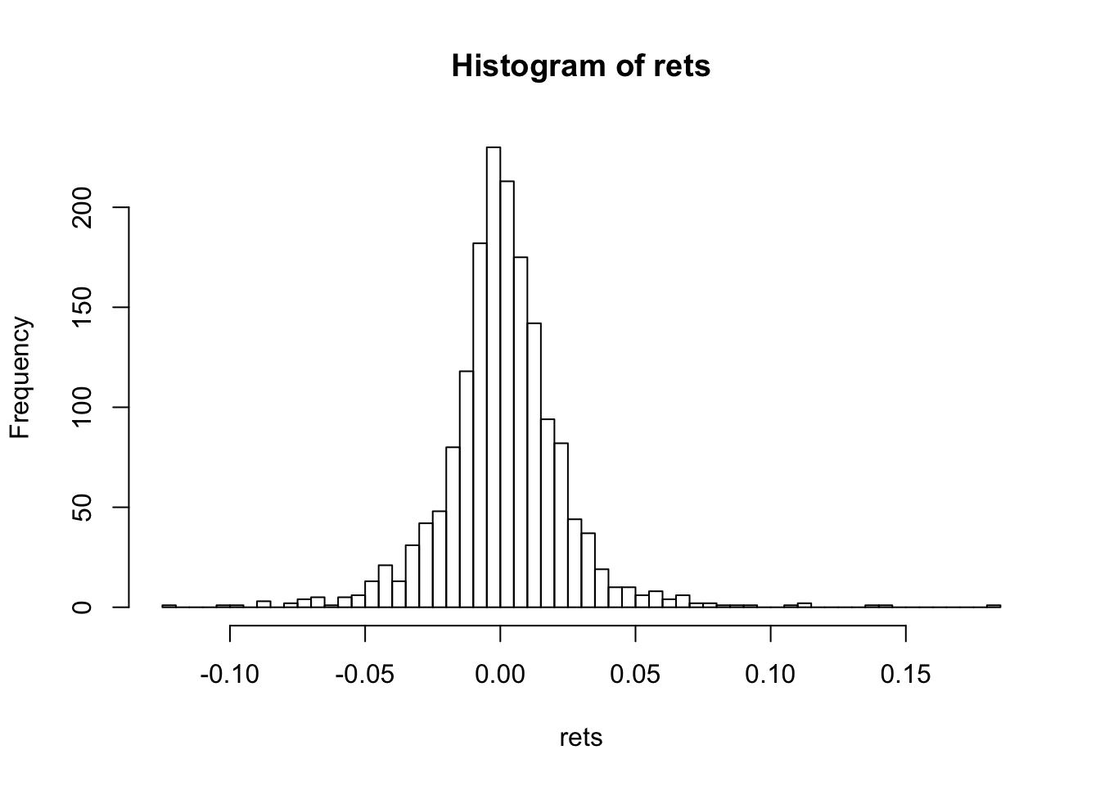
#HIGHER-ORDER MOMENTS
library(moments)
hist(rets,50)

Slide 12
print(c("Skewness=",skewness(rets)))
## [1] "Skewness=" "0.487479193296115"
print(c("Kurtosis=",kurtosis(rets)))
## [1] "Kurtosis=" "9.95591572103069"
For the normal distribution, skewness is zero, and kurtosis is 3. Kurtosis minus three is denoted “excess kurtosis”.
skewness(rnorm(1000000))
## [1] 0.001912514
kurtosis(rnorm(1000000))
## [1] 2.995332

Slide 13
Homework
What is the skewness and kurtosis of the stock index (S&P500)?

Slide 14
Matrices
x = matrix(rnorm(12),4,3)
print(x)
## [,1] [,2] [,3]
## [1,] -0.69430984 0.7897995 0.3524628
## [2,] 1.08377771 0.7380866 0.4088171
## [3,] -0.37520601 -1.3140870 2.0383614
## [4,] -0.06818956 -0.6813911 0.1423782

Slide 15
Transposing the matrix, notice that the dimensions are reversed.
print(t(x),3)
## [,1] [,2] [,3] [,4]
## [1,] -0.694 1.084 -0.375 -0.0682
## [2,] 0.790 0.738 -1.314 -0.6814
## [3,] 0.352 0.409 2.038 0.1424

Slide 16
print(t(x) %*% x,3)
## [,1] [,2] [,3]
## [1,] 1.802 0.791 -0.576
## [2,] 0.791 3.360 -2.195
## [3,] -0.576 -2.195 4.467
print(x %*% t(x),3)
## [,1] [,2] [,3] [,4]
## [1,] 1.2301 -0.0254 -0.0589 -0.441
## [2,] -0.0254 1.8865 -0.5432 -0.519
## [3,] -0.0589 -0.5432 6.0225 1.211
## [4,] -0.4406 -0.5186 1.2112 0.489

Slide 17
#CREATE A RANDOM MATRIX
x = matrix(runif(12),4,3)
print(x)
## [,1] [,2] [,3]
## [1,] 0.9508065 0.3802924 0.7496199
## [2,] 0.2546922 0.2621244 0.9214230
## [3,] 0.3521408 0.1808846 0.8633504
## [4,] 0.9065475 0.2655430 0.7270766

Slide 18
print(x*2)
## [,1] [,2] [,3]
## [1,] 1.9016129 0.7605847 1.499240
## [2,] 0.5093844 0.5242488 1.842846
## [3,] 0.7042817 0.3617692 1.726701
## [4,] 1.8130949 0.5310859 1.454153
print(x+x)
## [,1] [,2] [,3]
## [1,] 1.9016129 0.7605847 1.499240
## [2,] 0.5093844 0.5242488 1.842846
## [3,] 0.7042817 0.3617692 1.726701
## [4,] 1.8130949 0.5310859 1.454153

Slide 19
print(t(x) %*% x) #THIS SHOULD BE 3x3
## [,1] [,2] [,3]
## [1,] 1.9147325 0.7327696 1.910573
## [2,] 0.7327696 0.3165638 0.875839
## [3,] 1.9105731 0.8758390 2.684965
#print(x %*% x) #SHOULD GIVE AN ERROR

Slide 20
Taking the inverse of the covariance matrix, we get:
cv_inv = solve(cv)
print(cv_inv,3)
## goog aapl csco ibm
## goog 4670 -1430 -1099 -1011
## aapl -1430 3766 -811 -1122
## csco -1099 -811 4801 -2452
## ibm -1011 -1122 -2452 8325
Check that the inverse is really so!
print(cv_inv %*% cv,3)
## goog aapl csco ibm
## goog 1.00e+00 -2.78e-16 -1.94e-16 -2.78e-17
## aapl -2.78e-17 1.00e+00 8.33e-17 -5.55e-17
## csco 1.67e-16 1.11e-16 1.00e+00 1.11e-16
## ibm 0.00e+00 -2.22e-16 -2.22e-16 1.00e+00

Slide 21
It is, the result of multiplying the inverse matrix by the matrix itself results in the identity matrix.
A covariance matrix should be positive definite. Why? What happens if it is not? Checking for this property is easy.
library(corpcor)
is.positive.definite(cv)
## [1] TRUE
What happens if you compute pairwise covariances from differing lengths of data for each pair?
Let’s take the returns data we have and find the inverse.
cv = cov(rets)
print(round(cv,6))
## SUNW MSFT IBM CSCO AMZN
## SUNW 0.001438 0.000324 0.000310 0.000717 0.000459
## MSFT 0.000324 0.000365 0.000197 0.000330 0.000268
## IBM 0.000310 0.000197 0.000299 0.000283 0.000206
## CSCO 0.000717 0.000330 0.000283 0.000950 0.000504
## AMZN 0.000459 0.000268 0.000206 0.000504 0.001648
cv_inv = solve(cv) #TAKE THE INVERSE
print(round(cv_inv %*% cv,2)) #CHECK THAT WE GET IDENTITY MATRIX
## SUNW MSFT IBM CSCO AMZN
## SUNW 1 0 0 0 0
## MSFT 0 1 0 0 0
## IBM 0 0 1 0 0
## CSCO 0 0 0 1 0
## AMZN 0 0 0 0 1
#CHECK IF MATRIX IS POSITIVE DEFINITE (why do we check this?)
library(corpcor)
is.positive.definite(cv)
## [1] TRUE

Slide 22

Root Finding
Finding roots of nonlinear equations is often required, and R has several packages for this purpose. Here we examine a few examples. Suppose we are given the function

Slide 23
and for various values of y we wish to solve for the values of x . The function we use is called multiroot and the use of the function is shown below.
#ROOT SOLVING IN R
library(rootSolve)
fn = function(x,y) {
result = (x^2+y^2-1)^3 - x^2*y^3
}
yy = 1
sol = multiroot(f=fn,start=1,maxiter=10000,rtol=0.000001,atol=0.000001,ctol=0.00001,y=yy)
print(c("solution=",sol$root))
## [1] "solution=" "1"
check = fn(sol$root,yy)
print(check)
## [1] 0
Here we demonstrate the use of another function called uniroot.
fn = function(x) {
result = 0.065*(x*(1-x))^0.5- 0.05 +0.05*x
}
sol = uniroot.all(f=fn,c(0,1))
print(sol)
## [1] 1.0000000 0.3717627
check = fn(sol)
print(check)
## [1] 0.000000e+00 1.041576e-06

Slide 24
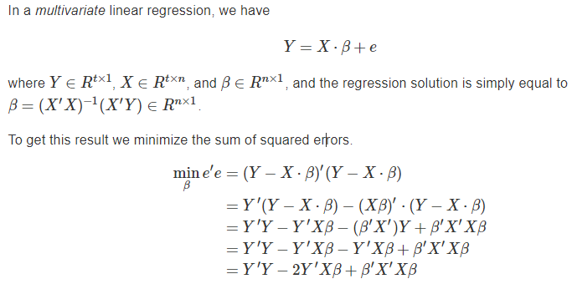
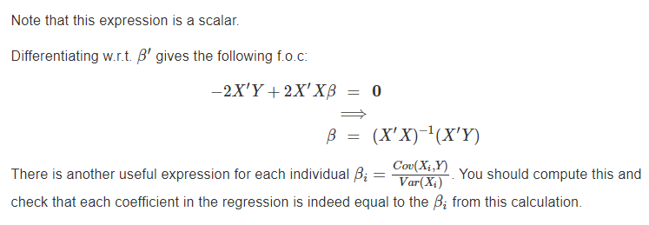
Regression

Slide 25
Example: We run a stock return regression to exemplify the algebra above.
data = read.table("DSTMAA_data/markowitzdata.txt",header=TRUE) #THESE DATA ARE RETURNS
print(names(data)) #THIS IS A DATA FRAME (important construct in R)
## [1] "X.DATE" "SUNW" "MSFT" "IBM" "CSCO" "AMZN" "mktrf"
## [8] "smb" "hml" "rf"
head(data)

Slide 26
## X.DATE SUNW MSFT IBM CSCO AMZN
## 1 20010102 -0.087443948 0.000000000 -0.002205882 -0.129084975 -0.10843374
## 2 20010103 0.297297299 0.105187319 0.115696386 0.240150094 0.26576576
## 3 20010104 -0.060606062 0.010430248 -0.015191546 0.013615734 -0.11743772
## 4 20010105 -0.096774191 0.014193549 0.008718981 -0.125373140 -0.06048387
## 5 20010108 0.006696429 -0.003816794 -0.004654255 -0.002133106 0.02575107
## 6 20010109 0.044345897 0.058748405 -0.010688043 0.015818726 0.09623431
## mktrf smb hml rf
## 1 -0.0345 -0.0037 0.0209 0.00026
## 2 0.0527 0.0097 -0.0493 0.00026
## 3 -0.0121 0.0083 -0.0015 0.00026
## 4 -0.0291 0.0027 0.0242 0.00026
## 5 -0.0037 -0.0053 0.0129 0.00026
## 6 0.0046 0.0044 -0.0026 0.00026

Slide 27
#RUN A MULTIVARIATE REGRESSION ON STOCK DATA
Y = as.matrix(data$SUNW)
X = as.matrix(data[,3:6])
res = lm(Y~X)
summary(res)
##
## Call:
## lm(formula = Y ~ X)
##
## Residuals:
## Min 1Q Median 3Q Max
## -0.233758 -0.014921 -0.000711 0.014214 0.178859
##

Slide 28
## Coefficients:
## Estimate Std. Error t value Pr(>|t|)
## (Intercept) -0.0007256 0.0007512 -0.966 0.33422
## XMSFT 0.1382312 0.0529045 2.613 0.00907 **
## XIBM 0.3791500 0.0566232 6.696 3.02e-11 ***
## XCSCO 0.5769097 0.0317799 18.153 < 2e-16 ***
## XAMZN 0.0324899 0.0204802 1.586 0.11286
## ---
## Signif. codes: 0 '***' 0.001 '**' 0.01 '*' 0.05 '.' 0.1 ' ' 1
##
## Residual standard error: 0.02914 on 1502 degrees of freedom
## Multiple R-squared: 0.4112, Adjusted R-squared: 0.4096
## F-statistic: 262.2 on 4 and 1502 DF, p-value: < 2.2e-16

Slide 29
Now we can cross-check the regression using the algebraic solution for the regression coefficients.
#CHECK THE REGRESSION
n = length(Y)
X = cbind(matrix(1,n,1),X)
b = solve(t(X) %*% X) %*% (t(X) %*% Y)
print(b)
## [,1]
## -0.0007256342
## MSFT 0.1382312148
## IBM 0.3791500328
## CSCO 0.5769097262
## AMZN 0.0324898716

Slide 30
#REGRESSION ON NCAA BASKETBALL PLAYOFF DATA
ncaa = read.table("DSTMAA_data/ncaa.txt",header=TRUE)
print(head(ncaa))
## No NAME GMS PTS REB AST TO A.T STL BLK PF FG FT
## 1 1 NorthCarolina 6 84.2 41.5 17.8 12.8 1.39 6.7 3.8 16.7 0.514 0.664
## 2 2 Illinois 6 74.5 34.0 19.0 10.2 1.87 8.0 1.7 16.5 0.457 0.753
## 3 3 Louisville 5 77.4 35.4 13.6 11.0 1.24 5.4 4.2 16.6 0.479 0.702
## 4 4 MichiganState 5 80.8 37.8 13.0 12.6 1.03 8.4 2.4 19.8 0.445 0.783
## 5 5 Arizona 4 79.8 35.0 15.8 14.5 1.09 6.0 6.5 13.3 0.542 0.759
## 6 6 Kentucky 4 72.8 32.3 12.8 13.5 0.94 7.3 3.5 19.5 0.510 0.663
## X3P
## 1 0.417
## 2 0.361
## 3 0.376
## 4 0.329
## 5 0.397
## 6 0.400
y = ncaa[3]
y = as.matrix(y)
x = ncaa[4:14]
x = as.matrix(x)
fm = lm(y~x)
res = summary(fm)
res
##
## Call:
## lm(formula = y ~ x)
##
## Residuals:
## Min 1Q Median 3Q Max
## -1.5074 -0.5527 -0.2454 0.6705 2.2344
##
## Coefficients:
## Estimate Std. Error t value Pr(>|t|)
## (Intercept) -10.194804 2.892203 -3.525 0.000893 ***
## xPTS -0.010442 0.025276 -0.413 0.681218
## xREB 0.105048 0.036951 2.843 0.006375 **
## xAST -0.060798 0.091102 -0.667 0.507492
## xTO -0.034545 0.071393 -0.484 0.630513
## xA.T 1.325402 1.110184 1.194 0.237951
## xSTL 0.181015 0.068999 2.623 0.011397 *
## xBLK 0.007185 0.075054 0.096 0.924106
## xPF -0.031705 0.044469 -0.713 0.479050
## xFG 13.823190 3.981191 3.472 0.001048 **
## xFT 2.694716 1.118595 2.409 0.019573 *
## xX3P 2.526831 1.754038 1.441 0.155698
## ---
## Signif. codes: 0 '***' 0.001 '**' 0.01 '*' 0.05 '.' 0.1 ' ' 1
##
## Residual standard error: 0.9619 on 52 degrees of freedom
## Multiple R-squared: 0.5418, Adjusted R-squared: 0.4448
## F-statistic: 5.589 on 11 and 52 DF, p-value: 7.889e-06

Slide 31
Parts of a regression
The linear regression is fit by minimizing the sum of squared errors, but the same concept may also be applied to a nonlinear regression as well.
which describes a data set that has n rows and p columns, which are the standard variables for the number of rows and columns. Note that the error term (residual) is ϵi

Slide 32
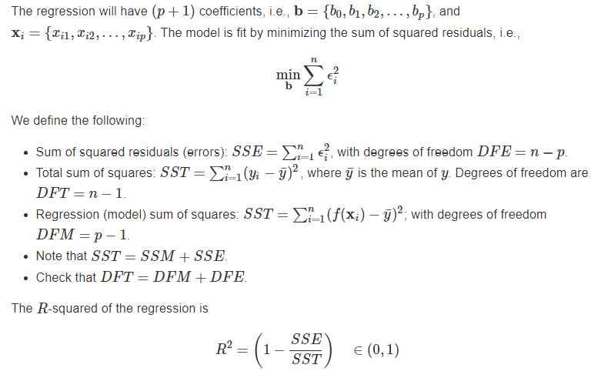

Slide 33
The F-statistic in the regression is what tells us if the RHS variables comprise a model that explains the LHS variable sufficiently. Do the RHS variables offer more of an explanation that simply assuming that the mean value of y is the best prediction? The null hypothesis we care about is

Slide 34
H0: bk=0,k=0,1,2,...,p versus an alternate hypothesis of
H1: bk≠0 for at least one k.

Slide 35
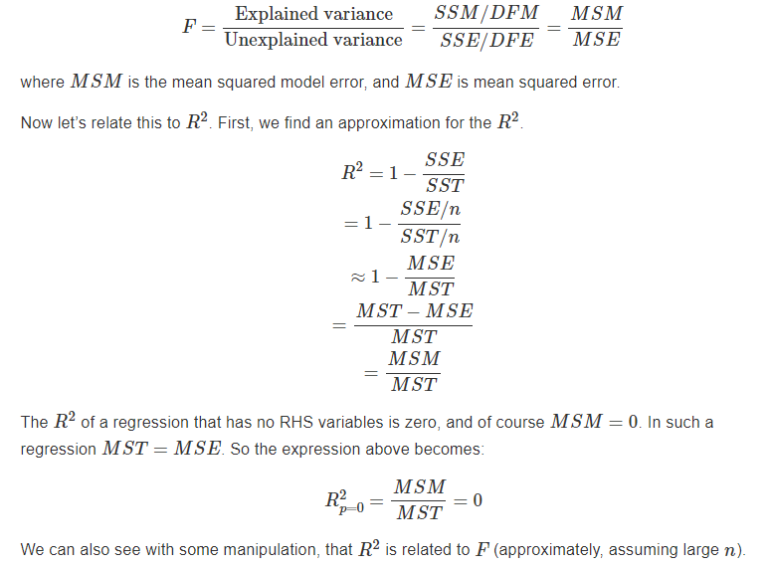
To test this the F-statistic is computed as the following ratio:

Slide 36
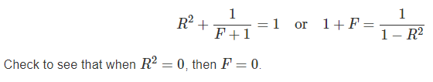

Slide 37
x = matrix(runif(300),100,3)
y = 5 + 4*x[,1] + 3*x[,2] + 2*x[,3] + rnorm(100)
y = as.matrix(y)
res = lm(y~x)
print(summary(res))
##
## Call:
## lm(formula = y ~ x)
##
## Residuals:
## Min 1Q Median 3Q Max
## -2.7194 -0.5876 0.0410 0.7223 2.5900
##

Slide 38
## Coefficients:
## Estimate Std. Error t value Pr(>|t|)
## (Intercept) 5.0819 0.3141 16.178 < 2e-16 ***
## x1 4.3444 0.3753 11.575 < 2e-16 ***
## x2 2.8944 0.3335 8.679 1.02e-13 ***
## x3 1.8143 0.3397 5.341 6.20e-07 ***
## ---
## Signif. codes: 0 '***' 0.001 '**' 0.01 '*' 0.05 '.' 0.1 ' ' 1
##
## Residual standard error: 1.005 on 96 degrees of freedom
## Multiple R-squared: 0.7011, Adjusted R-squared: 0.6918
## F-statistic: 75.06 on 3 and 96 DF, p-value: < 2.2e-16

Slide 39
e = res$residuals
SSE = sum(e^2)
SST = sum((y-mean(y))^2)
SSM = SST - SSE
print(c(SSE,SSM,SST))
## [1] 97.02772 227.60388 324.63160
R2 = 1 - SSE/SST
print(R2)
## [1] 0.7011144
n = dim(x)[1]
p = dim(x)[2]+1
MSE = SSE/(n-p)
MSM = SSM/(p-1)
MST = SST/(n-1)
print(c(n,p,MSE,MSM,MST))
## [1] 100.000000 4.000000 1.010705 75.867960 3.279107
Fstat = MSM/MSE
print(Fstat)
## [1] 75.06436

Slide 40
We can also compare two regressions, say one with 5 RHS variables with one that has only 3 of those five to see whether the additional two variables has any extra value.
The ratio of the two MSM values from the first and second regressions is also a F-statistic that may be tested for it to be large enough.
Note that if the residuals ϵϵ are assumed to be normally distributed, then squared residuals are distributed as per the chi-square (χ2) distribution.
Further, the sum of residuals is distributed normal and the sum of squared residuals is distributed χ2. And finally, the ratio of two χ2 variables is F-distributed, which is why we call it the F-statistic, it is the ratio of two sums of squared errors.

Slide 41
Heteroskedasticity
Simple linear regression assumes that the standard error of the residuals is the same for all observations. Many regressions suffer from the failure of this condition.
The word for this is “heteroskedastic” errors. “Hetero” means different, and “skedastic” means dependent on type.

Slide 42
We can first test for the presence of heteroskedasticity using a standard Breusch-Pagan test available in R. This resides in the lmtest package which is loaded in before running the test.
ncaa = read.table("DSTMAA_data/ncaa.txt",header=TRUE)
y = as.matrix(ncaa[3])
x = as.matrix(ncaa[4:14])
result = lm(y~x)
library(lmtest)
bptest(result)
##
## studentized Breusch-Pagan test
##
## data: result
## BP = 15.538, df = 11, p-value = 0.1592
We can see that there is very little evidence of heteroskedasticity in the standard errors as the pp-value is not small.

Slide 43
However, lets go ahead and correct the t-statistics for heteroskedasticity as follows, using the hccm function.
The hccm stands for heteroskedasticity corrected covariance matrix.

Slide 44
wuns = matrix(1,64,1)
z = cbind(wuns,x)
b = solve(t(z) %*% z) %*% (t(z) %*% y)
result = lm(y~x)
library(car)
vb = hccm(result)
stdb = sqrt(diag(vb))
tstats = b/stdb
print(tstats)

Slide 45
## GMS
## -2.68006069
## PTS -0.38212818
## REB 2.38342637
## AST -0.40848721
## TO -0.28709450
## A.T 0.65632053
## STL 2.13627108
## BLK 0.09548606
## PF -0.68036944
## FG 3.52193532
## FT 2.35677255
## X3P 1.23897636
Compare these to the t-statistics in the original model

Slide 46
summary(result)
##
## Call:
## lm(formula = y ~ x)
##
## Residuals:
## Min 1Q Median 3Q Max
## -1.5074 -0.5527 -0.2454 0.6705 2.2344
##

Slide 47
## Coefficients:
## Estimate Std. Error t value Pr(>|t|)
## (Intercept) -10.194804 2.892203 -3.525 0.000893 ***
## xPTS -0.010442 0.025276 -0.413 0.681218
## xREB 0.105048 0.036951 2.843 0.006375 **
## xAST -0.060798 0.091102 -0.667 0.507492
## xTO -0.034545 0.071393 -0.484 0.630513
## xA.T 1.325402 1.110184 1.194 0.237951
## xSTL 0.181015 0.068999 2.623 0.011397 *
## xBLK 0.007185 0.075054 0.096 0.924106
## xPF -0.031705 0.044469 -0.713 0.479050
## xFG 13.823190 3.981191 3.472 0.001048 **
## xFT 2.694716 1.118595 2.409 0.019573 *
## xX3P 2.526831 1.754038 1.441 0.155698
## ---
## Signif. codes: 0 '***' 0.001 '**' 0.01 '*' 0.05 '.' 0.1 ' ' 1
##
## Residual standard error: 0.9619 on 52 degrees of freedom
## Multiple R-squared: 0.5418, Adjusted R-squared: 0.4448
## F-statistic: 5.589 on 11 and 52 DF, p-value: 7.889e-06

Slide 48
It is apparent that when corrected for heteroskedasticity, the t-statistics in the regression are lower, and also render some of the previously significant coefficients insignificant.

Slide 49
Auto-Regressive Models
When data is autocorrelated, i.e., has dependence in time, not accounting for this issue results in unnecessarily high statistical significance (in terms of inflated t-statistics). Intuitively, this is because observations are treated as independent when actually they are correlated in time, and therefore, the true number of observations is effectively less.

Slide 50
Consider a finance application. In efficient markets, the correlation of stock returns from one period to the next should be close to zero.
We use the returns on Google stock as an example. First, read in the data.

Slide 51
data = read.csv("DSTMAA_data/goog.csv",header=TRUE)
head(data)
## Date Open High Low Close Volume Adj.Close
## 1 2011-04-06 572.18 575.16 568.00 574.18 2668300 574.18
## 2 2011-04-05 581.08 581.49 565.68 569.09 6047500 569.09
## 3 2011-04-04 593.00 594.74 583.10 587.68 2054500 587.68
## 4 2011-04-01 588.76 595.19 588.76 591.80 2613200 591.80
## 5 2011-03-31 583.00 588.16 581.74 586.76 2029400 586.76
## 6 2011-03-30 584.38 585.50 580.58 581.84 1422300 581.84

Slide 52
Next, create the returns time series.
n = length(data$Close)
stkp = rev(data$Adj.Close)
rets = as.matrix(log(stkp[2:n]/stkp[1:(n-1)]))
n = length(rets)
plot(rets,type="l",col="blue")

Slide 54
print(n)
## [1] 1670
Examine the autocorrelation. This is one lag, also known as first-order autocorrelation.
cor(rets[1:(n-1)],rets[2:n])
## [1] 0.007215026
Run the Durbin-Watson test for autocorrelation. Here we test for up to 10 lags.

Slide 55
library(car)
res = lm(rets[2:n]~rets[1:(n-1)])
durbinWatsonTest(res,max.lag=10)
## lag Autocorrelation D-W Statistic p-value
## 1 -0.0006436855 2.001125 0.950
## 2 -0.0109757002 2.018298 0.696
## 3 -0.0002853870 1.996723 0.982
## 4 0.0252586312 1.945238 0.324
## 5 0.0188824874 1.957564 0.444
## 6 -0.0555810090 2.104550 0.018
## 7 0.0020507562 1.989158 0.986
## 8 0.0746953706 1.843219 0.004
## 9 -0.0375308940 2.067304 0.108
## 10 0.0085641680 1.974756 0.798
## Alternative hypothesis: rho[lag] != 0
There is no evidence of auto-correlation when the DW statistic is close to 2. If the DW-statistic is greater than 2 it indicates negative autocorrelation, and if it is less than 2, it indicates positive autocorrelation.

Slide 56
If there is autocorrelation we can correct for it as follows. Let’s take a different data set.
md = read.table("DSTMAA_data/markowitzdata.txt",header=TRUE)
names(md)
## [1] "X.DATE" "SUNW" "MSFT" "IBM" "CSCO" "AMZN" "mktrf"
## [8] "smb" "hml" "rf"
Test for autocorrelation.
y = as.matrix(md[2])
x = as.matrix(md[7:9])
rf = as.matrix(md[10])
y = y-rf
library(car)
results = lm(y ~ x)
print(summary(results))

Slide 57
##
## Call:
## lm(formula = y ~ x)
##
## Residuals:
## Min 1Q Median 3Q Max
## -0.213676 -0.014356 -0.000733 0.014462 0.191089
##
## Coefficients:
## Estimate Std. Error t value Pr(>|t|)
## (Intercept) -0.000197 0.000785 -0.251 0.8019
## xmktrf 1.657968 0.085816 19.320 <2e-16 ***
## xsmb 0.299735 0.146973 2.039 0.0416 *
## xhml -1.544633 0.176049 -8.774 <2e-16 ***
## ---
## Signif. codes: 0 '***' 0.001 '**' 0.01 '*' 0.05 '.' 0.1 ' ' 1
##
## Residual standard error: 0.03028 on 1503 degrees of freedom
## Multiple R-squared: 0.3636, Adjusted R-squared: 0.3623
## F-statistic: 286.3 on 3 and 1503 DF, p-value: < 2.2e-16

Slide 58
durbinWatsonTest(results,max.lag=6)
## lag Autocorrelation D-W Statistic p-value
## 1 -0.07231926 2.144549 0.008
## 2 -0.04595240 2.079356 0.122
## 3 0.02958136 1.926791 0.180
## 4 -0.01608143 2.017980 0.654
## 5 -0.02360625 2.032176 0.474
## 6 -0.01874952 2.021745 0.594
## Alternative hypothesis: rho[lag] != 0
Now make the correction to the t-statistics. We use the procedure formulated by Newey and West (1987). This correction is part of the car package.

Slide 59
#CORRECT FOR AUTOCORRELATION
library(sandwich)
b = results$coefficients
print(b)
## (Intercept) xmktrf xsmb xhml
## -0.0001970164 1.6579682191 0.2997353765 -1.5446330690
vb = NeweyWest(results,lag=1)
stdb = sqrt(diag(vb))
tstats = b/stdb
print(tstats)
## (Intercept) xmktrf xsmb xhml
## -0.2633665 15.5779184 1.8300340 -6.1036120
Compare these to the stats we had earlier. Notice how they have come down after correction for AR. Note that there are several steps needed to correct for autocorrelation, and it might have been nice to roll one’s own function for this. (I leave this as an exercise for you.)

Slide 60
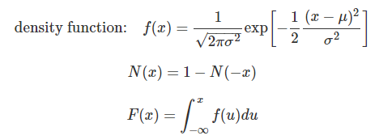
Maximum Likelihood
Assume that the stock returns R(t) mentioned above have a normal distribution with mean μ and variance σ2 per year. MLE estimation requires finding the parameters {μ,σ} that maximize the likelihood of seeing the empirical sequence of returns R(t) . A normal probability function is required, and we have one above for R(t) , which is assumed to be i.i.d. (independent and identically distributed).
First, a quick recap of the normal distribution. If x∼N(μ,σ2) , then

Slide 61
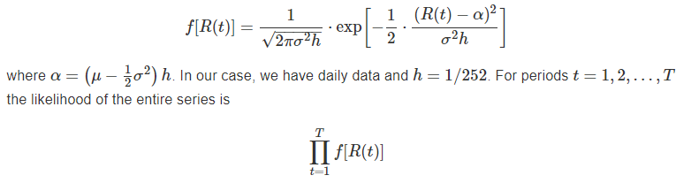
The standard normal distribution is x∼N(0,1). For the standard normal distribution: F(0)=1/2 .
Noting that when returns are i.i.d., the mean return and the variance of returns scale with time, and therefore, the standard deviation of returns scales with the square-root of time. If the time intervals between return observations is h years, then the probability density of R(t) is normal with the following equation:

Slide 62
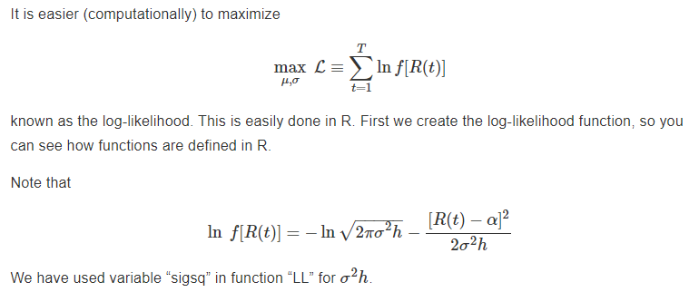

Slide 63
#LOG-LIKELIHOOD FUNCTION
LL = function(params,rets) {
alpha = params[1]; sigsq = params[2]
logf = -log(sqrt(2*pi*sigsq)) - (rets-alpha)^2/(2*sigsq)
LL = -sum(logf)
}

Slide 64
We now read in the data and maximize the log-likelihood to find the required parameters of the return distribution.
#READ DATA
data = read.csv("DSTMAA_data/goog.csv",header=TRUE)
stkp = data$Adj.Close
#Ln of differenced stk prices gives continuous returns
rets = diff(log(stkp)) #diff() takes first differences
print(c("mean return = ",mean(rets),mean(rets)*252))
## [1] "mean return = " "-0.00104453803410475" "-0.263223584594396"
print(c("stdev returns = ",sd(rets),sd(rets)*sqrt(252)))
## [1] "stdev returns = " "0.0226682330750677" "0.359847044267268"
#Create starting guess for parameters
params = c(0.001,0.001)
res = nlm(LL,params,rets)
print(res)

Slide 65
## $minimum
## [1] -3954.813
##
## $estimate
## [1] -0.0010450602 0.0005130408
##
## $gradient
## [1] -0.07215158 -1.93982032
##
## $code
## [1] 2
##
## $iterations
## [1] 8

Slide 66
Let’s annualize the parameters and see what they are, comparing them to the raw mean and variance of returns.
h = 1/252
alpha = res$estimate[1]
sigsq = res$estimate[2]
print(c("alpha=",alpha))
## [1] "alpha=" "-0.00104506019968994"
print(c("sigsq=",sigsq))
## [1] "sigsq=" "0.000513040809008682"
sigma = sqrt(sigsq/h)
mu = alpha/h + 0.5*sigma^2
print(c("mu=",mu))
## [1] "mu=" "-0.19871202838677"
print(c("sigma=",sigma))
## [1] "sigma=" "0.359564019154014"
print(mean(rets*252))
## [1] -0.2632236
print(sd(rets)*sqrt(252))
## [1] 0.359847
As we can see, the parameters under the normal distribution are quite close to the raw moments.

Slide 67
Logit
In linear regression model we placed no restrictions on the dependent variable.
However, when the LHS variable in a regression is categorical and binary, i.e., takes the value 1 or 0, then a logit regression is more apt.
This regression fits a model that will always return a fitted value of the dependent variable that lies between (0,1) .
This class of specifications covers what are known as limited dependent variables models.

Slide 68
Example: For the NCAA data, there are 64 observatios (teams) ordered from best to worst.
We take the top 32 teams and make their dependent variable 1 (above median teams), and that of the bottom 32 teams zero (below median).
Our goal is to fit a regression model that returns a team’s predicted percentile ranking.

Slide 69
First, we create the dependent variable.
y = c(rep(1,32),rep(0,32))
print(y)
## [1] 1 1 1 1 1 1 1 1 1 1 1 1 1 1 1 1 1 1 1 1 1 1 1 1 1 1 1 1 1 1 1 1 0 0 0
## [36] 0 0 0 0 0 0 0 0 0 0 0 0 0 0 0 0 0 0 0 0 0 0 0 0 0 0 0 0 0
x = as.matrix(ncaa[,4:14])
y = as.matrix(y)
We use the function glm for this task. Running the model is pretty easy as follows.
h = glm(y~x, family=binomial(link="logit"))
print(logLik(h))
## 'log Lik.' -21.44779 (df=12)
print(summary(h))

Slide 70
##
## Call:
## glm(formula = y ~ x, family = binomial(link = "logit"))
##
## Deviance Residuals:
## Min 1Q Median 3Q Max
## -1.80174 -0.40502 -0.00238 0.37584 2.31767
##

Slide 71
## Coefficients:
## Estimate Std. Error z value Pr(>|z|)
## (Intercept) -45.83315 14.97564 -3.061 0.00221 **
## xPTS -0.06127 0.09549 -0.642 0.52108
## xREB 0.49037 0.18089 2.711 0.00671 **
## xAST 0.16422 0.26804 0.613 0.54010
## xTO -0.38405 0.23434 -1.639 0.10124
## xA.T 1.56351 3.17091 0.493 0.62196
## xSTL 0.78360 0.32605 2.403 0.01625 *
## xBLK 0.07867 0.23482 0.335 0.73761
## xPF 0.02602 0.13644 0.191 0.84874
## xFG 46.21374 17.33685 2.666 0.00768 **
## xFT 10.72992 4.47729 2.397 0.01655 *
## xX3P 5.41985 5.77966 0.938 0.34838

Slide 72
## ---
## Signif. codes: 0 '***' 0.001 '**' 0.01 '*' 0.05 '.' 0.1 ' ' 1
##
## (Dispersion parameter for binomial family taken to be 1)
##
## Null deviance: 88.723 on 63 degrees of freedom
## Residual deviance: 42.896 on 52 degrees of freedom
## AIC: 66.896
##
## Number of Fisher Scoring iterations: 6

Slide 73

Thus, we see that the best variables that separate upper-half teams from lower-half teams are the number of rebounds and the field goal percentage. To a lesser extent, field goal percentage and steals also provide some explanatory power.
The logit regression is specified as follows:

Slide 74
The original data z={0,1} . The range of values of y is (−∞,+∞) . And as required, the fitted z∈(0,1) . The variables x are the RHS variables. The fitting is done using MLE.

Slide 75
Suppose we ran this with a simple linear regression.
h = lm(y~x)
summary(h)

Slide 76
##
## Call:
## lm(formula = y ~ x)
##
## Residuals:
## Min 1Q Median 3Q Max
## -0.65982 -0.26830 0.03183 0.24712 0.83049
##
## Coefficients:
## Estimate Std. Error t value Pr(>|t|)
## (Intercept) -4.114185 1.174308 -3.503 0.000953 ***
## xPTS -0.005569 0.010263 -0.543 0.589709
## xREB 0.046922 0.015003 3.128 0.002886 **
## xAST 0.015391 0.036990 0.416 0.679055
## xTO -0.046479 0.028988 -1.603 0.114905
## xA.T 0.103216 0.450763 0.229 0.819782
## xSTL 0.063309 0.028015 2.260 0.028050 *
## xBLK 0.023088 0.030474 0.758 0.452082
## xPF 0.011492 0.018056 0.636 0.527253
## xFG 4.842722 1.616465 2.996 0.004186 **
## xFT 1.162177 0.454178 2.559 0.013452 *
## xX3P 0.476283 0.712184 0.669 0.506604
## ---

Slide 77
## Signif. codes: 0 '***' 0.001 '**' 0.01 '*' 0.05 '.' 0.1 ' ' 1
##
## Residual standard error: 0.3905 on 52 degrees of freedom
## Multiple R-squared: 0.5043, Adjusted R-squared: 0.3995
## F-statistic: 4.81 on 11 and 52 DF, p-value: 4.514e-05

Slide 78

Probit
We can redo the same regression in the logit using a probit instead. A probit is identical in spirit to the logit regression, except that the function that is used is
where Φ(⋅) is the cumulative normal probability function.

Slide 79
h = glm(y~x, family=binomial(link="probit"))
print(logLik(h))
## 'log Lik.' -21.27924 (df=12)
print(summary(h))

Slide 80
##
## Call:
## glm(formula = y ~ x, family = binomial(link = "probit"))
##
## Deviance Residuals:
## Min 1Q Median 3Q Max
## -1.76353 -0.41212 -0.00031 0.34996 2.24568
##
## Coefficients:
## Estimate Std. Error z value Pr(>|z|)
## (Intercept) -26.28219 8.09608 -3.246 0.00117 **
## xPTS -0.03463 0.05385 -0.643 0.52020
## xREB 0.28493 0.09939 2.867 0.00415 **
## xAST 0.10894 0.15735 0.692 0.48874

Slide 81
## xTO -0.23742 0.13642 -1.740 0.08180 .
## xA.T 0.71485 1.86701 0.383 0.70181
## xSTL 0.45963 0.18414 2.496 0.01256 *
## xBLK 0.03029 0.13631 0.222 0.82415
## xPF 0.01041 0.07907 0.132 0.89529
## xFG 26.58461 9.38711 2.832 0.00463 **
## xFT 6.28278 2.51452 2.499 0.01247 *
## xX3P 3.15824 3.37841 0.935 0.34988
## ---
## Signif. codes: 0 '***' 0.001 '**' 0.01 '*' 0.05 '.' 0.1 ' ' 1
##
## (Dispersion parameter for binomial family taken to be 1)
##
## Null deviance: 88.723 on 63 degrees of freedom
## Residual deviance: 42.558 on 52 degrees of freedom
## AIC: 66.558
##
## Number of Fisher Scoring iterations: 8
The results confirm those obtained from the linear regression and logit regression.

Slide 82

ARCH and GARCH
GARCH stands for “Generalized Auto-Regressive Conditional Heteroskedasticity”. Engle (1982) invented ARCH (for which he got the Nobel prize) and this was extended by Bollerslev (1986) to GARCH.
ARCH models are based on the idea that volatility tends to cluster, i.e., volatility for period t , is auto-correlated with volatility from period (t−1) , or more preceding periods. If we had a time series of stock returns following a random walk, we might model it as follows

Slide 83
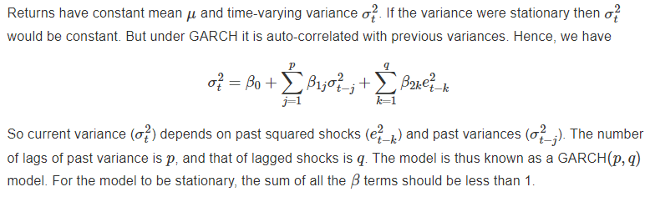

Slide 84
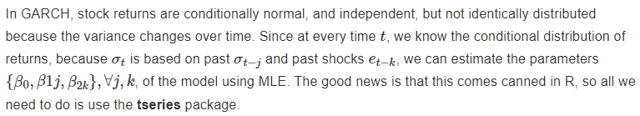

Slide 85
library(tseries)
res = garch(rets,order=c(1,1))

Slide 86
##
## ***** ESTIMATION WITH ANALYTICAL GRADIENT *****
##
##
## I INITIAL X(I) D(I)
##
## 1 4.624639e-04 1.000e+00
## 2 5.000000e-02 1.000e+00
## 3 5.000000e-02 1.000e+00
##
## IT NF F RELDF PRELDF RELDX STPPAR D*STEP NPRELDF

Slide 87
## 0 1 -5.512e+03
## 1 7 -5.513e+03 1.82e-04 2.97e-04 2.0e-04 4.3e+09 2.0e-05 6.33e+05
## 2 8 -5.513e+03 8.45e-06 9.19e-06 1.9e-04 2.0e+00 2.0e-05 1.57e+01
## 3 15 -5.536e+03 3.99e-03 6.04e-03 4.4e-01 2.0e+00 8.0e-02 1.56e+01
## 4 18 -5.569e+03 6.02e-03 4.17e-03 7.4e-01 1.9e+00 3.2e-01 4.54e-01
## 5 20 -5.579e+03 1.85e-03 1.71e-03 7.9e-02 2.0e+00 6.4e-02 1.67e+02
## 6 22 -5.604e+03 4.44e-03 3.94e-03 1.3e-01 2.0e+00 1.3e-01 1.93e+04
## 7 24 -5.610e+03 9.79e-04 9.71e-04 2.2e-02 2.0e+00 2.6e-02 2.93e+06
## 8 26 -5.621e+03 1.92e-03 1.96e-03 4.1e-02 2.0e+00 5.1e-02 2.76e+08
## 9 27 -5.639e+03 3.20e-03 4.34e-03 7.4e-02 2.0e+00 1.0e-01 2.26e+02
## 10 34 -5.640e+03 2.02e-04 3.91e-04 3.7e-06 4.0e+00 5.5e-06 1.73e+01
## 11 35 -5.640e+03 7.02e-06 8.09e-06 3.6e-06 2.0e+00 5.5e-06 5.02e+00
## 12 36 -5.640e+03 2.22e-07 2.36e-07 3.7e-06 2.0e+00 5.5e-06 5.26e+00
## 13 43 -5.641e+03 2.52e-04 3.98e-04 1.5e-02 2.0e+00 2.3e-02 5.26e+00
## 14 45 -5.642e+03 2.28e-04 1.40e-04 1.7e-02 0.0e+00 3.2e-02 1.40e-04

Slide 88
## 15 46 -5.644e+03 3.17e-04 3.54e-04 3.9e-02 1.0e-01 8.8e-02 3.57e-04
## 16 56 -5.644e+03 1.60e-05 3.69e-05 5.7e-07 3.2e+00 9.7e-07 6.48e-05
## 17 57 -5.644e+03 1.91e-06 1.96e-06 5.0e-07 2.0e+00 9.7e-07 1.20e-05
## 18 58 -5.644e+03 8.57e-11 5.45e-09 5.2e-07 2.0e+00 9.7e-07 9.38e-06
## 19 66 -5.644e+03 6.92e-06 9.36e-06 4.2e-03 6.2e-02 7.8e-03 9.38e-06
## 20 67 -5.644e+03 7.42e-07 1.16e-06 1.2e-03 0.0e+00 2.2e-03 1.16e-06
## 21 68 -5.644e+03 8.44e-08 1.50e-07 7.1e-04 0.0e+00 1.6e-03 1.50e-07
## 22 69 -5.644e+03 1.39e-08 2.44e-09 8.6e-05 0.0e+00 1.8e-04 2.44e-09
## 23 70 -5.644e+03 -7.35e-10 1.24e-11 3.1e-06 0.0e+00 5.4e-06 1.24e-11
##
## ***** RELATIVE FUNCTION CONVERGENCE *****
##
## FUNCTION -5.644379e+03 RELDX 3.128e-06
## FUNC. EVALS 70 GRAD. EVALS 23
## PRELDF 1.242e-11 NPRELDF 1.242e-11
##
## I FINAL X(I) D(I) G(I)
##
## 1 1.807617e-05 1.000e+00 1.035e+01
## 2 1.304314e-01 1.000e+00 -2.837e-02
## 3 8.457819e-01 1.000e+00 -2.915e-02

Slide 89
summary(res)

Slide 90
##
## Call:
## garch(x = rets, order = c(1, 1))
##
## Model:
## GARCH(1,1)
##
## Residuals:
## Min 1Q Median 3Q Max
## -9.17102 -0.59191 -0.03853 0.43929 4.64677
##
## Coefficient(s):
## Estimate Std. Error t value Pr(>|t|)
## a0 1.808e-05 2.394e-06 7.551 4.33e-14 ***
## a1 1.304e-01 1.292e-02 10.094 < 2e-16 ***
## b1 8.458e-01 1.307e-02 64.720 < 2e-16 ***
## ---

Slide 91
## Signif. codes: 0 '***' 0.001 '**' 0.01 '*' 0.05 '.' 0.1 ' ' 1
##
## Diagnostic Tests:
## Jarque Bera Test
##
## data: Residuals
## X-squared = 3199.7, df = 2, p-value < 2.2e-16
##
##
## Box-Ljung test
##
## data: Squared.Residuals
## X-squared = 0.14094, df = 1, p-value = 0.7073

Slide 92
That’s it! Certainly much less painful than programming the entire MLE procedure. We see that the parameters {β0,β1,β2} are all statistically significant. Given the fitted parameters, we can also examine the extracted time series of volatilty.

Slide 93
#PLOT VOLATILITY TIMES SERIES
print(names(res))
## [1] "order" "coef" "n.likeli" "n.used"
## [5] "residuals" "fitted.values" "series" "frequency"
## [9] "call" "vcov"
plot(res$fitted.values[,1],type="l",col="red")
grid(lwd=2)

Slide 94
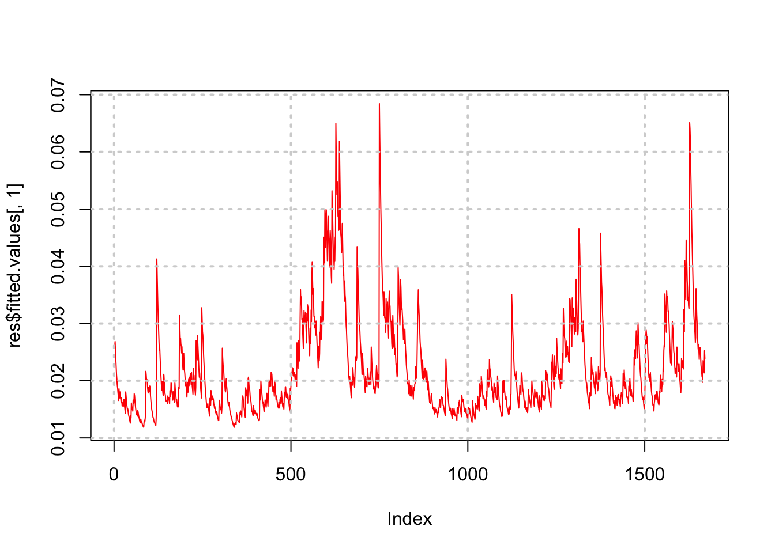

Slide 95
We may also plot is side by side with the stock price series.
par(mfrow=c(2,1))
plot(res$fitted.values[,1],col="blue",type="l")
plot(stkp,type="l",col="red")

Slide 96
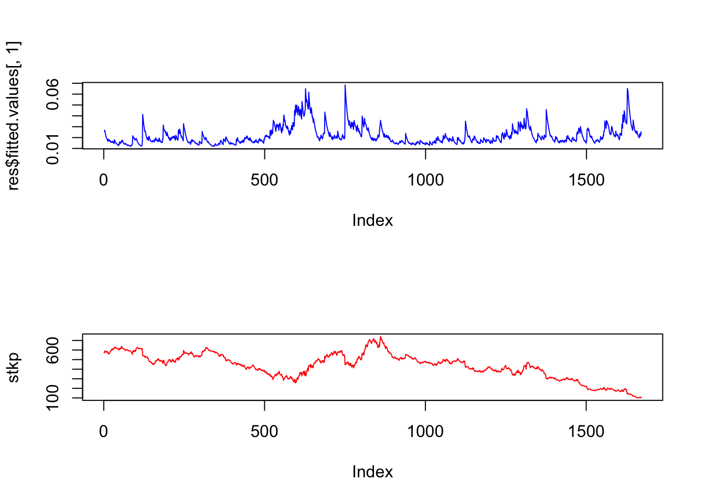
Notice how the volatility series clumps into periods of high volatility, interspersed with larger periods of calm. As is often the case, volatility tends to be higher when the stock price is lower.

Slide 97
Vector Autoregression
Also known as VAR (not the same thing as Value-at-Risk, denoted VaR).
VAR is useful for estimating systems where there are simultaneous regression equations, and the variables influence each other over time.
So in a VAR, each variable in a system is assumed to depend on lagged values of itself and the other variables.
The number of lags may be chosen by the econometrician based on the expected decay in time-dependence of the variables in the VAR.

Slide 98
In the following example, we examine the inter-relatedness of returns of the following three tickers: SUNW, MSFT, IBM.
For vector autoregressions (VARs), we run the following R commands:

Slide 99
md = read.table("DSTMAA_data/markowitzdata.txt",header=TRUE)
y = as.matrix(md[2:4])
library(stats)
var6 = ar(y,aic=TRUE,order=6)
print(var6$order)
## [1] 1
print(var6$ar)

Slide 100
## , , SUNW
##
## SUNW MSFT IBM
## 1 -0.00985635 0.02224093 0.002072782
##
## , , MSFT
##
## SUNW MSFT IBM
## 1 0.008658304 -0.1369503 0.0306552
##
## , , IBM
##
## SUNW MSFT IBM
## 1 -0.04517035 0.0975497 -0.01283037

Slide 101
We print out the Akaike Information Criterion (AIC)28 to see which lags are significant.
print(var6$aic)
## 0 1 2 3 4 5 6
## 23.950676 0.000000 2.762663 5.284709 5.164238 10.065300 8.924513
Since there are three stocks’ returns moving over time, we have a system of three equations, each with six lags, so there will be six lagged coefficients for each equation. We print out these coefficients here, and examine the sign. We note however that only one lag is significant, as the “order” of the system was estimated as 1 in the VAR above.

Slide 102
print(var6$partialacf)
## , , SUNW
##
## SUNW MSFT IBM
## 1 -0.00985635 0.022240931 0.002072782
## 2 -0.07857841 -0.019721982 -0.006210487
## 3 0.03382375 0.003658121 0.032990758
## 4 0.02259522 0.030023132 0.020925226
## 5 -0.03944162 -0.030654949 -0.012384084
## 6 -0.03109748 -0.021612632 -0.003164879
##
## , , MSFT
##
## SUNW MSFT IBM
## 1 0.008658304 -0.13695027 0.030655201
## 2 -0.053224374 -0.02396291 -0.047058278
## 3 0.080632420 0.03720952 -0.004353203
## 4 -0.038171317 -0.07573402 -0.004913021
## 5 0.002727220 0.05886752 0.050568308
## 6 0.242148823 0.03534206 0.062799122
##

Slide 103
## , , IBM
##
## SUNW MSFT IBM
## 1 -0.04517035 0.097549700 -0.01283037
## 2 0.05436993 0.021189756 0.05430338
## 3 -0.08990973 -0.077140955 -0.03979962
## 4 0.06651063 0.056250866 0.05200459
## 5 0.03117548 -0.056192843 -0.06080490
## 6 -0.13131366 -0.003776726 -0.01502191

Slide 104
Interestingly we see that each of the tickers has a negative relation to its lagged value, but a positive correlation with the lagged values of the other two stocks. Hence, there is positive cross autocorrelation amongst these tech stocks. We can also run a model with three lags.

Slide 105
ar(y,method="ols",order=3)
##
## Call:
## ar(x = y, order.max = 3, method = "ols")
##
## $ar
## , , 1
##
## SUNW MSFT IBM
## SUNW 0.01407 -0.0006952 -0.036839
## MSFT 0.02693 -0.1440645 0.100557
## IBM 0.01330 0.0211160 -0.009662
##
## , , 2
##

Slide 106
## SUNW MSFT IBM
## SUNW -0.082017 -0.04079 0.04812
## MSFT -0.020668 -0.01722 0.01761
## IBM -0.006717 -0.04790 0.05537
##
## , , 3
##
## SUNW MSFT IBM
## SUNW 0.035412 0.081961 -0.09139
## MSFT 0.003999 0.037252 -0.07719
## IBM 0.033571 -0.003906 -0.04031
##
##
## $x.intercept
## SUNW MSFT IBM
## -9.623e-05 -7.366e-05 -6.257e-05
##
## $var.pred
## SUNW MSFT IBM
## SUNW 0.0013593 0.0003007 0.0002842
## MSFT 0.0003007 0.0003511 0.0001888
## IBM 0.0002842 0.0001888 0.0002881

Slide 107
We examine cross autocorrelation found across all stocks by Lo and Mackinlay in their book “A Non-Random Walk Down Wall Street” – see Figure 3.2.

Slide 108
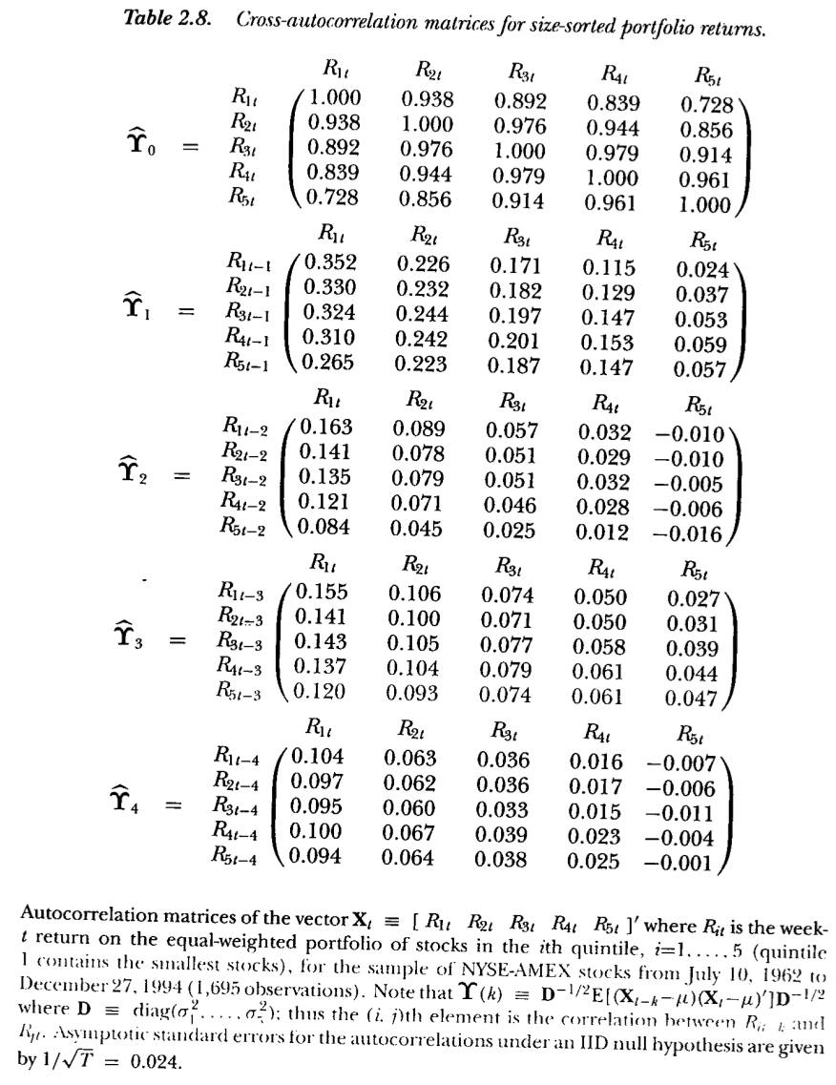

Slide 109
We see that one-lag cross autocorrelations are positive. Compare these portfolio autocorrelations with the individual stock autocorrelations in the example here.

Slide 110
Solving Non-Linear Equations
Recall root finding……………….
Here we develop it further. We have also not done much with user-generated functions. Here is a neat model in R to solve for the implied volatility in the Black-Merton-Scholes class of models. First, we code up the Black and Scholes (1973) model; this is the function bms73 below. Then we write a user-defined function that solves for the implied volatility from a given call or put option price. The package minpack.lm is used for the equation solving, and the function call is nls.lm.

Slide 111
If you are not familiar with the Nobel Prize winning Black-Scholes model, never mind, almost the entire world has never heard of it. Just think of it as a nonlinear multivariate function that we will use as an exemplar for equation solving. We are going to use the function below to solve for the value of sig in the expressions below. We set up two functions.

Slide 112
#Black-Merton-Scholes 1973
#sig: volatility
#S: stock price
#K: strike price
#T: maturity
#r: risk free rate
#q: dividend rate
#cp = 1 for calls and -1 for puts
#optprice: observed option price

Slide 113
bms73 = function(sig,S,K,T,r,q,cp=1,optprice) {
d1 = (log(S/K)+(r-q+0.5*sig^2)*T)/(sig*sqrt(T))
d2 = d1 - sig*sqrt(T)
if (cp==1) {
optval = S*exp(-q*T)*pnorm(d1)-K*exp(-r*T)*pnorm(d2)
}
else {
optval = -S*exp(-q*T)*pnorm(-d1)+K*exp(-r*T)*pnorm(-d2)
}
#If option price is supplied we want the implied vol, else optprice
bs = optval - optprice
}
#Function to return Imp Vol with starting guess sig0
impvol = function(sig0,S,K,T,r,q,cp,optprice) {
sol = nls.lm(par=sig0,fn=bms73,S=S,K=K,T=T,r=r,q=q,
cp=cp,optprice=optprice)
}

Slide 114
We use the minimizer to solve the nonlinear function for the value of sig. The calls to this model are as follows:
library(minpack.lm)
optprice = 4
res = impvol(0.2,40,40,1,0.03,0,-1,optprice)
print(names(res))
## [1] "par" "hessian" "fvec" "info" "message" "diag"
## [7] "niter" "rsstrace" "deviance"
print(c("Implied vol = ",res$par))
## [1] "Implied vol = " "0.291522285803426"

Slide 115
We note that the function impvol was written such that the argument that we needed to solve for, sig0, the implied volatility, was the first argument in the function. However, the expression par=sig0 does inform the solver which argument is being searched for in order to satisfy the non-linear equation for implied volatility. Note also that the function bms73 returns the difference between the model price and observed price, not the model price alone. This is necessary as the solver tries to set this function value to zero by finding the implied volatility.
Lets check if we put this volatility back into the bms function that we get back the option price of 4. Voila!

Slide 116
#CHECK
optp = bms73(res$par,40,40,1,0.03,0,0,4) + optprice
print(c("Check option price = ",optp))
## [1] "Check option price = " "4"

Slide 117
Question
?

